Slide 1
Conda
Presented by Raafat H

Slide 2
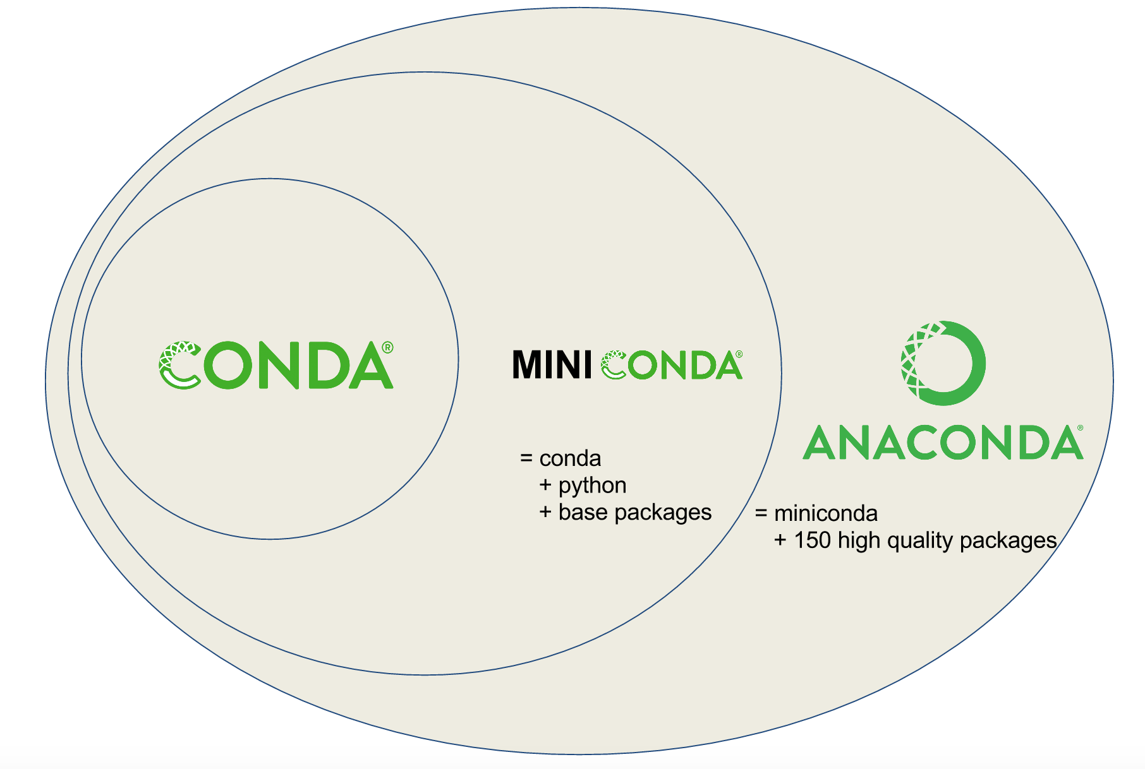
Conda Installations
Source: https://towardsdatascience.com/managing-project-specific-environments-with-conda-b8b50aa8be0e

Slide 3
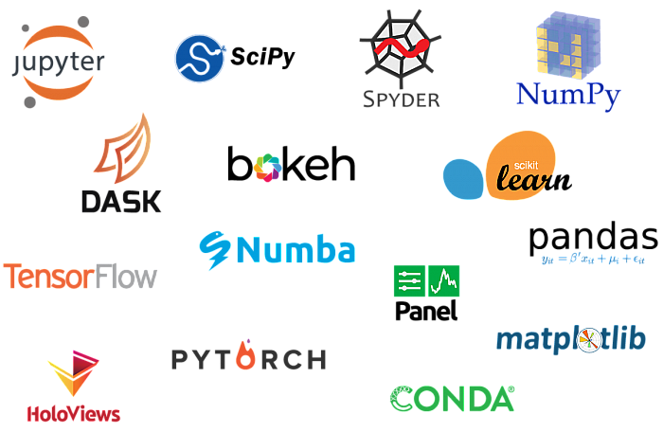
Anaconda pre-installed packages

Slide 4
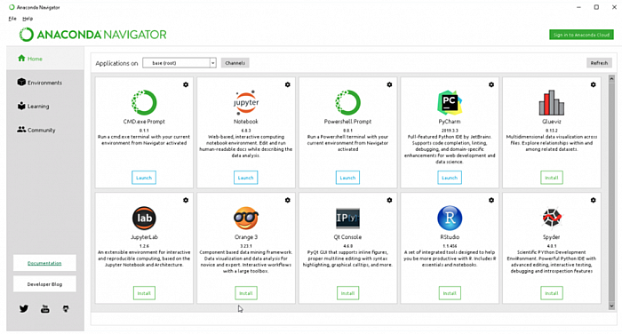
Anaconda Navigator makes it easy

Slide 5
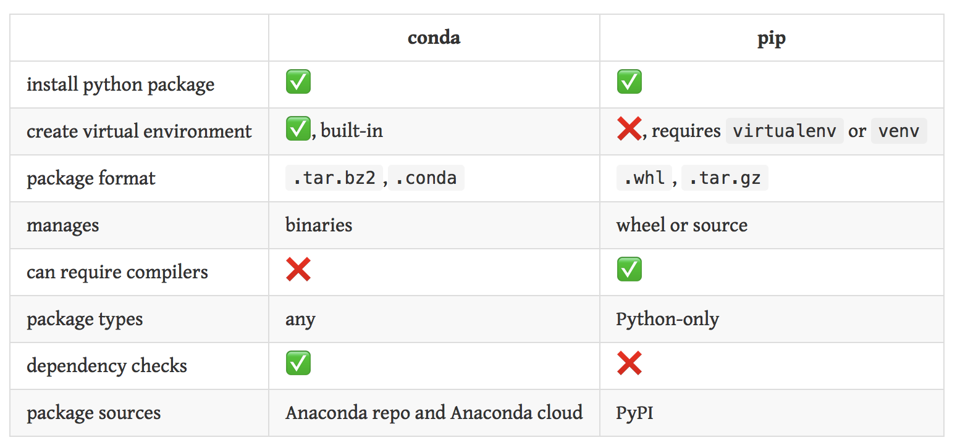
Conda Vs pip
Source:https://www.anaconda.com/blog/understanding-conda-and-pip

Slide 6
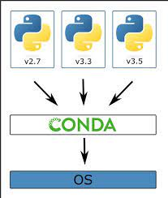
Benefits of Conda
Source:https://angus.readthedocs.io/en/2019/conda_tutorial.html

Slide 7
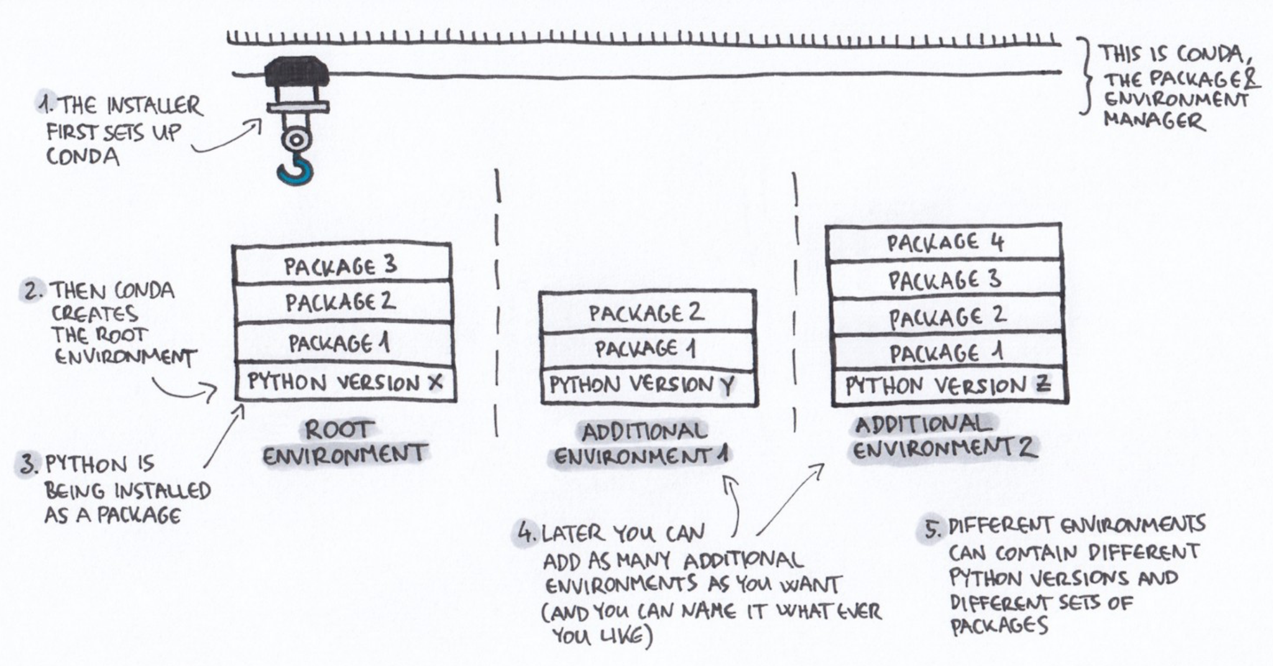
Benefits of Conda
Source:https://angus.readthedocs.io/en/2019/conda_tutorial.html

